Slide 1
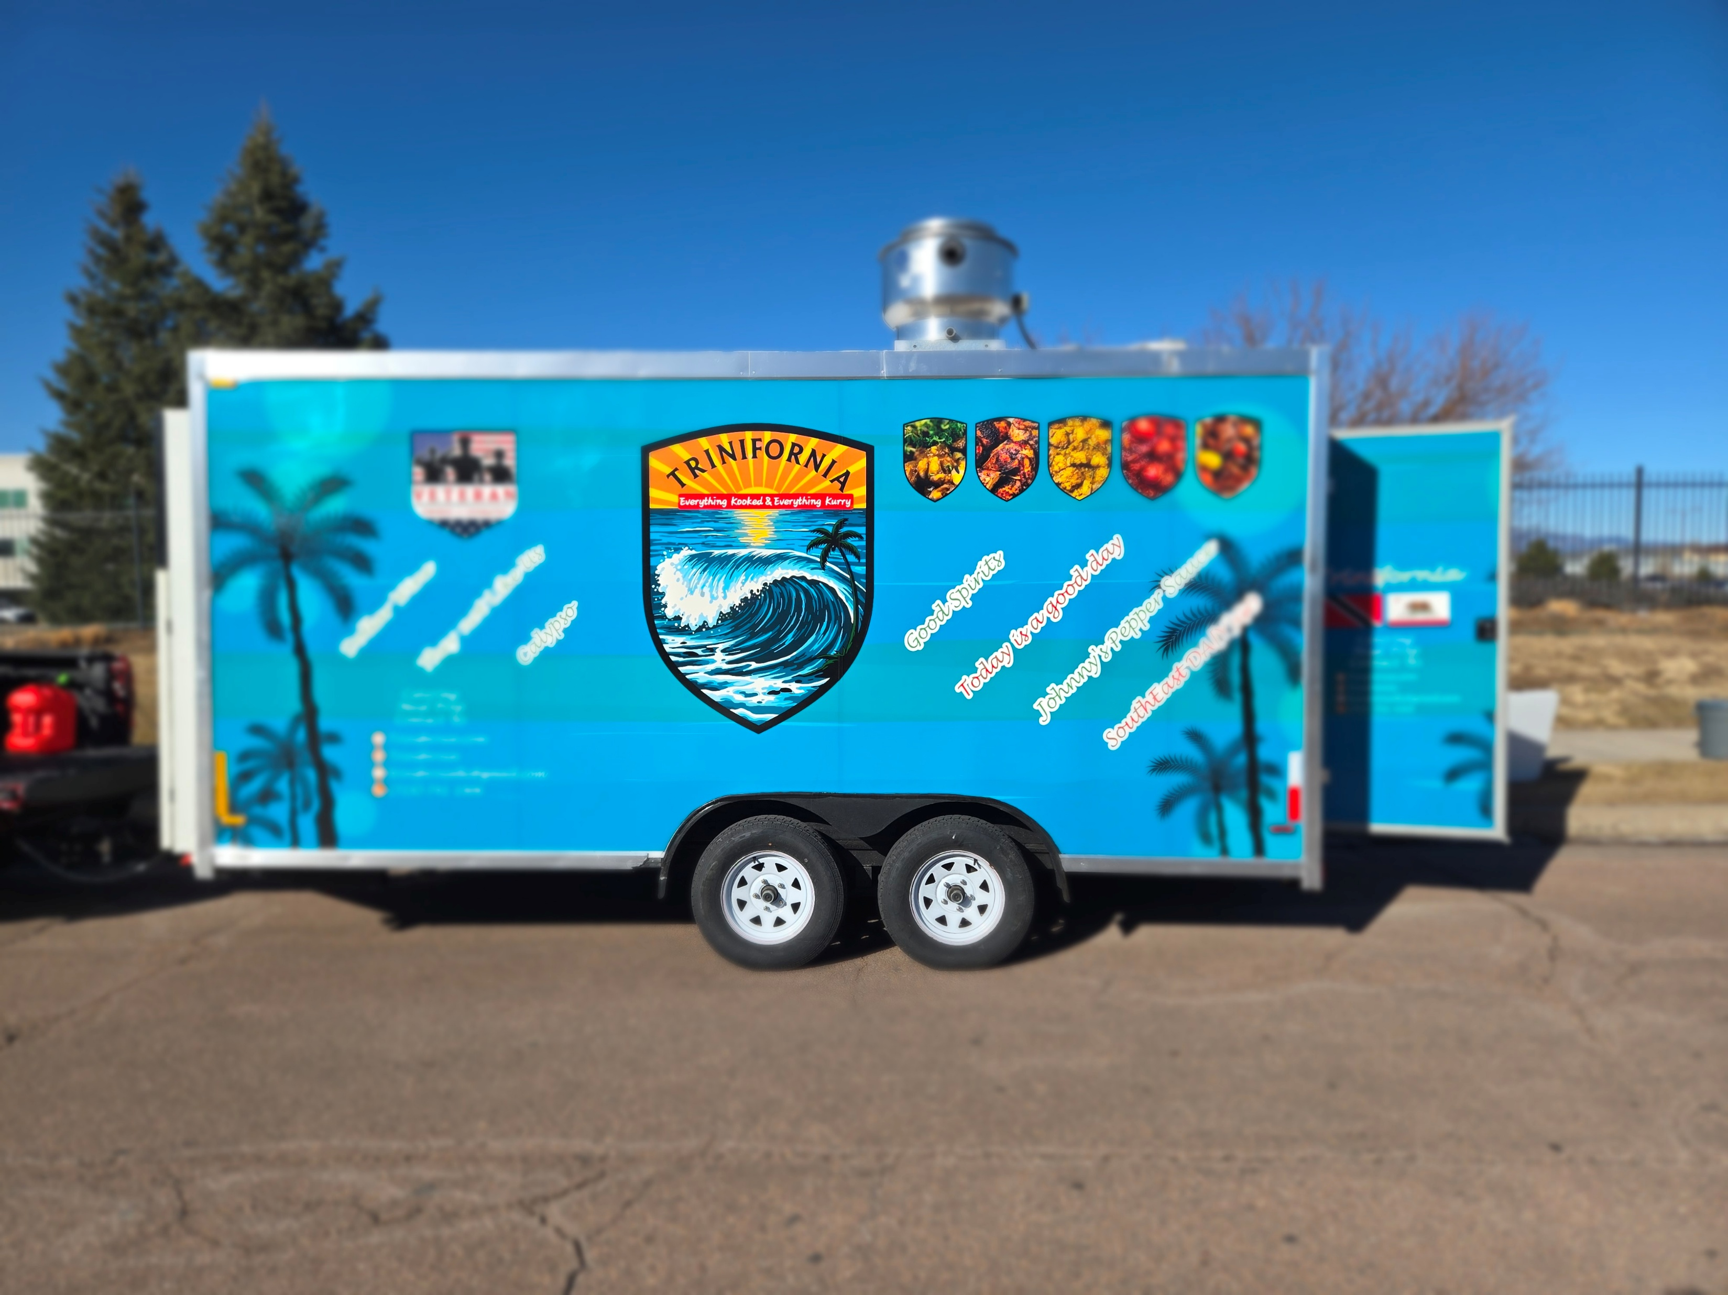
Trinifornia Food Trailer
Everything Kooked & Everything Kurry
9-13 March Schedule
Date | Location | Times
09 March | B-Street | 1130AM | 1:00PM
10 March | Amazon | 11:30AM | 1:30PM
11 March | B-Street | 11:30 | 1:00pm
12 March | Amazon | 11:30 | 1:00pm
13 March | B-Street | 11:30 | 1:00PM

